Slide 1
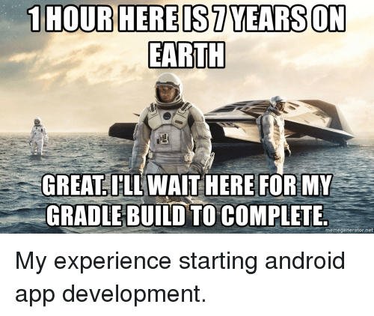
Android Application

Slide 2

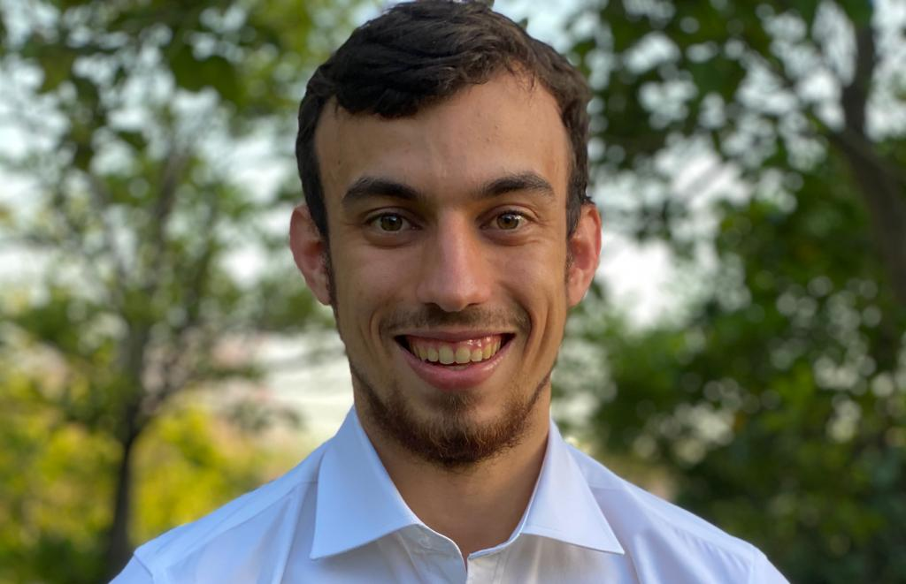
Submit by:
Einat Buznach 314905860
Omer Zivoni 313173825

Slide 3

About the course:
Course name: Advance Programming 2 Course number: 89211 Lecturer: Eli Halaschi Faculty: computer science University: Bar Ilan

Slide 4
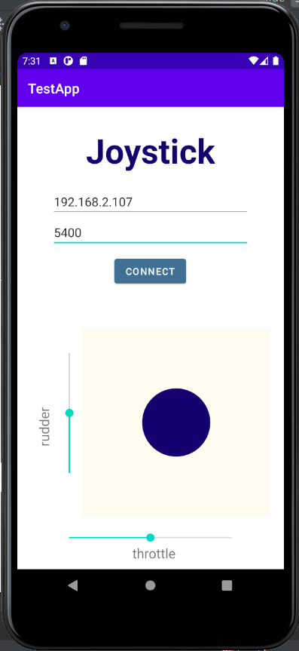

About our project:
We developed an Android App which allows you to control flight simulator that runs on remote device.
The application
The simulator
Notes:
אולי כדאי להסביר בקטנה את ההרכב של אפליקציית אנדרואיד:
Activities
Layouts

Slide 5

About the architecture we use – MVVM:
View-Model
Data binding
User
Commands
View
Operate
Model
Notes:
נקודות שלדעתי חשוב לומר:
להציג מה זה MVVM
למה זה מתאים לאפליקציית אנדרואיד (כי זה מוכוון איבנטים)
להראות איפה זה בא לידי ביטוי

Slide 6
UML Diagram
NOTATION:
Yellow box: note
Green box: provided by Android Studio
Dashed line: data binding
View
View Model
AppCompactActivity
virtual OnCreate() virtual OnStart() virtual OnResume()
View
virtual onMeasure virtual onDraw virtual onTouchEvent
Model
BaseObservable
Model
connectToServer(ip, port) – connect and run the app Setters (aileron, elevator, throttle, rudder)
AppCompactSeekBar
ViewModel
Private model Properties: Ip Port Throttle Rudder Elevator Aileron runModel() – runs the private model using ip, port properties
MainActivity
override OnCreate() override OnStart() override OnResume() MainActivity simply opens JoystickActivity
Updates via private model
VerticalSeekBar
Overrides the methods above in order to be used as vertical seekbar
ManageConnect
ConnectAndRun() AddToQueue(string) – add instruction to be passed StopRun()
JoystickActivity
override OnCreate() In charge of databinding and communication with VM
Joystick
Custom view component with circle used to control the plane
The view is what the user sees and uses to control the system. Activities are like programs.
Controls the program.
“properties” are updated by the view and passed to model.
Its job is to connect the server and send data given by the view model, when any update is made
Main adjustable views we used. There are more native ones.

